Slide 1

SOFTWARE ENGINERRING GPS SYSTEM
Group Cherry
Knight 2030026123
Joshua 2030026117 Vicky 2030026116
Frye 2030026258 Unknown 2030026213

Slide 2



TABLE OF CONTENTS
01
02
03
INTRODUCTION
SYSTEM DESIGN
What is our system
How we design the system
04
LIVE DEMO
SYSTEM IMPLEMENTATION
What we implemented
Demostrate our system

Slide 3
01
INTRODUCTION

Slide 4

INTRODUCTION
“Graduation Placement Service”
Students about to graduate
postgraduate (PG) universities

Slide 5
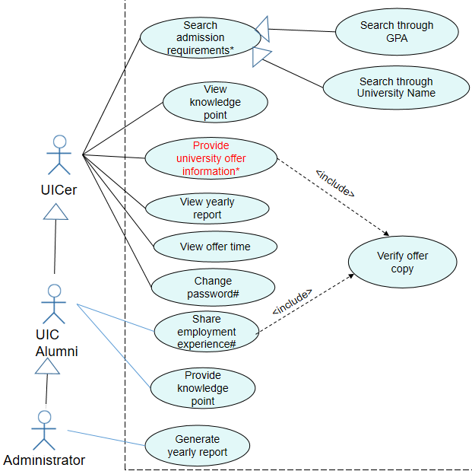
Features
Search admission requirement
Provide offer information
Provide knowledge point
View knowledge point
View yearly report
State transition diagram

Slide 6
02
SYSTEM DESIGN

Slide 7
Development
Object-Oriented Development
– Object-Oriented Analysis (Requirements specification)
– Object-Oriented Design (Architectural Design)
– Object Design (Detailed Design)
– Object-Oriented Programming (Implementation)

Slide 8
Requirements specification
SRS (Software Requirements Specification)
-Browser
-Python
-Database

Slide 9
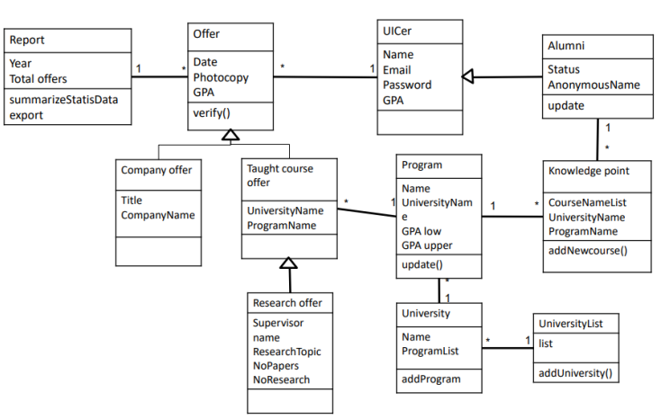
Class diagram
Participating entities
Relationships
Logical relationships between tables

Slide 10
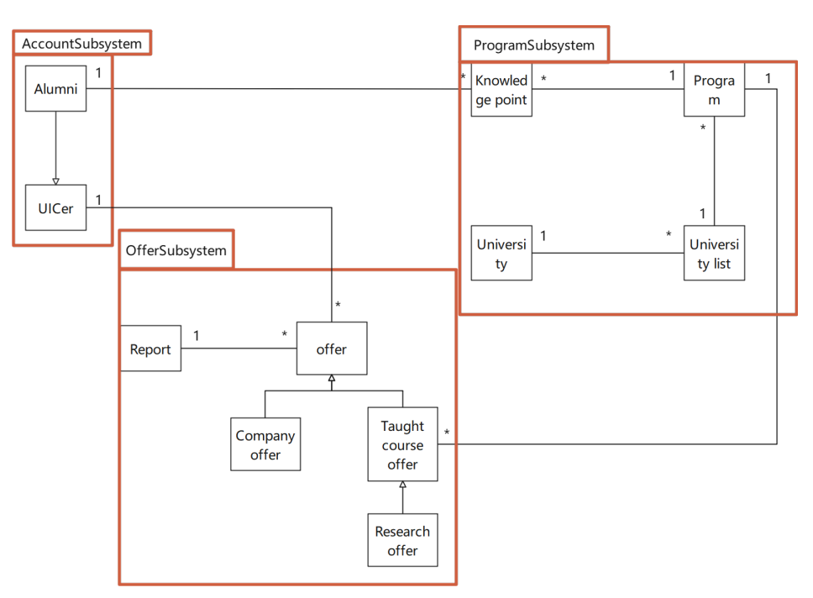
Architecture
three subsystems
Low coupling
High cohesion

Slide 11
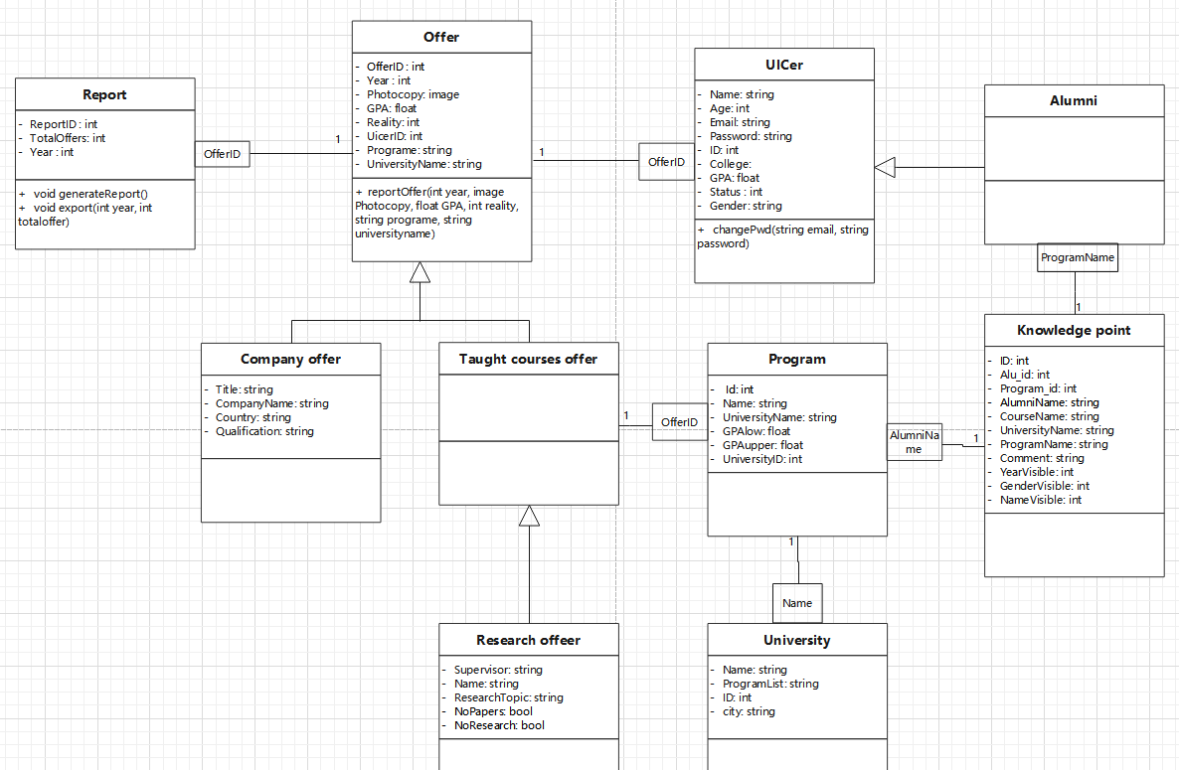
Foreign key
Qualifier
Detailed Class diagram

Slide 12
03
SYSTEM IMPLEMENTATION
Notes:
Now we are going to talk about what we implemented

Slide 13
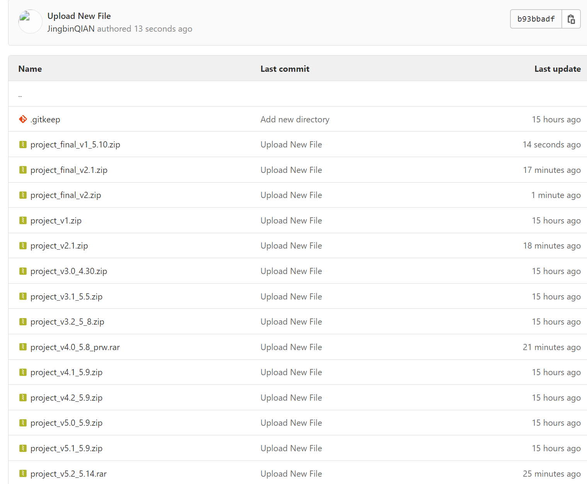
version control
16 versions
Notes:
During our implementation, we use gitlab to do the version control

Slide 14
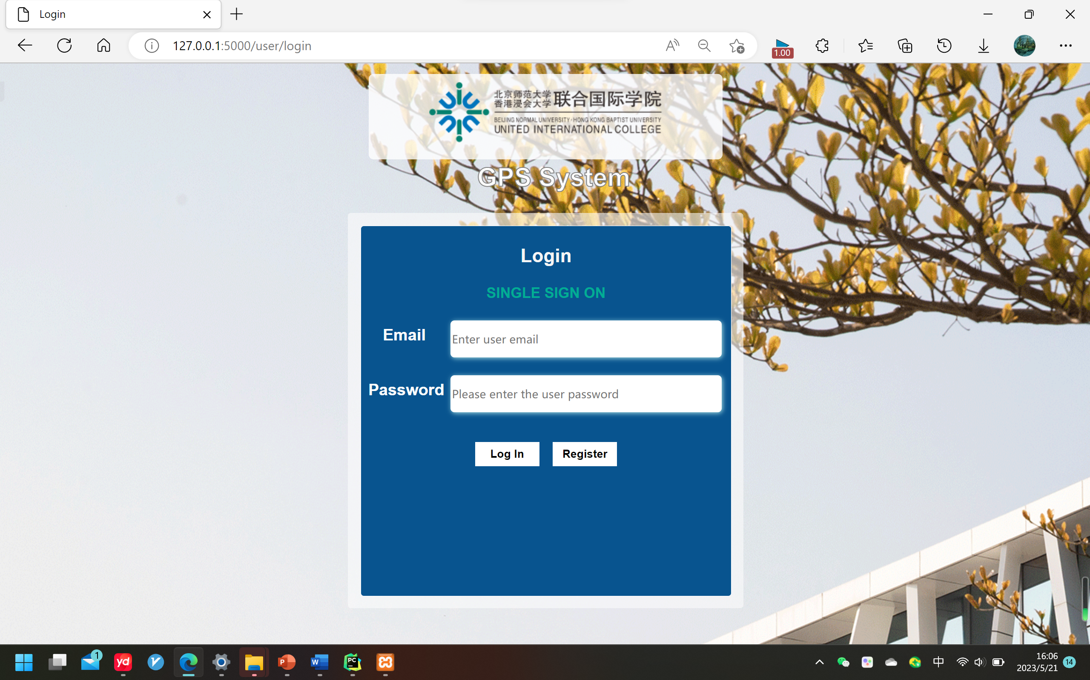
System Overview
Notes:
This is our system, now let’s learn more about the system

Slide 15
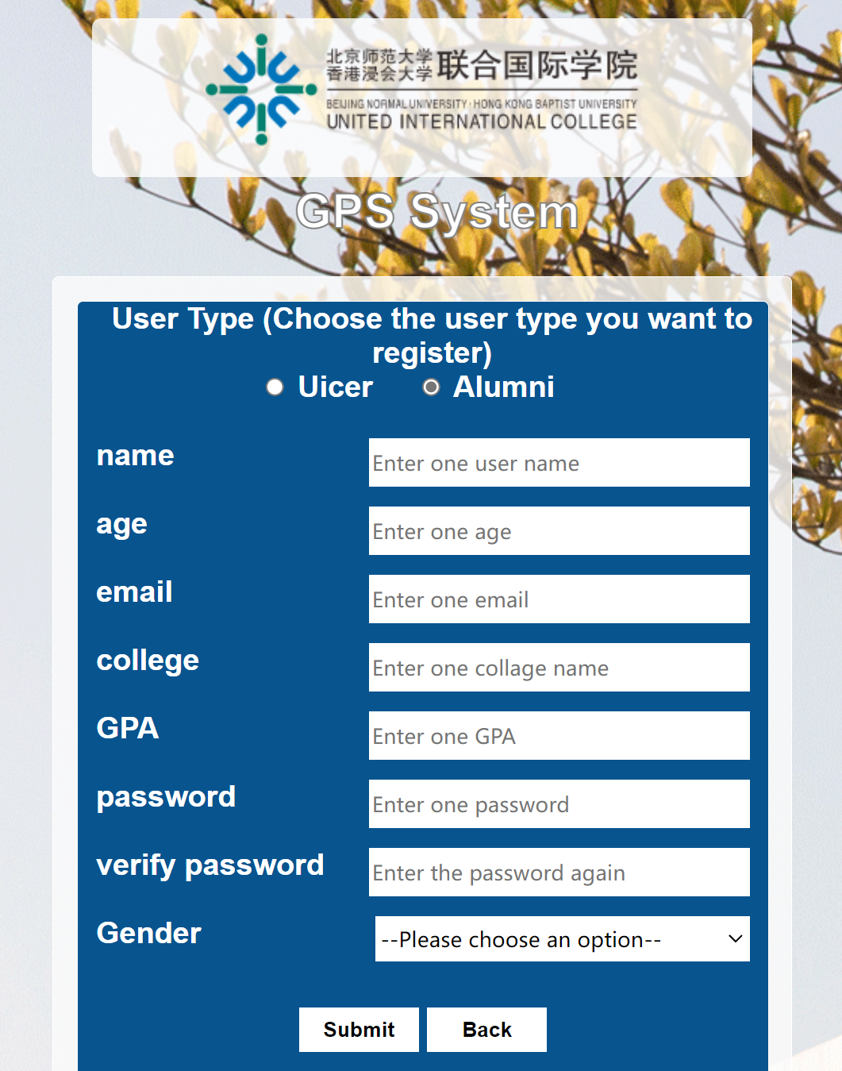
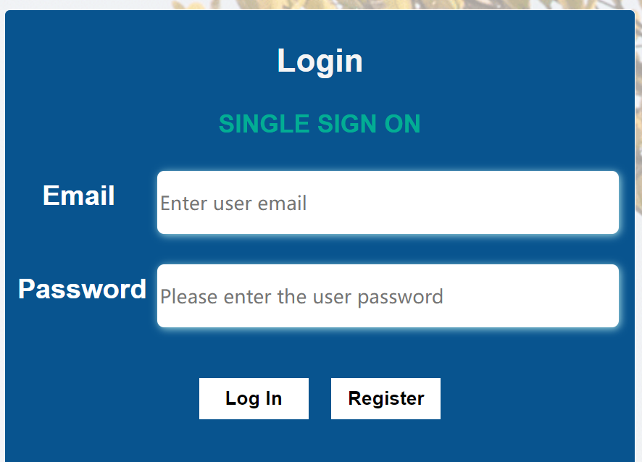
Register
Notes:
New users can enter our system by registering a new account. Click the "register" button to enter the registration page. users can choose to register as a UICer or as an Alumni, and fill in relevant information

Slide 16
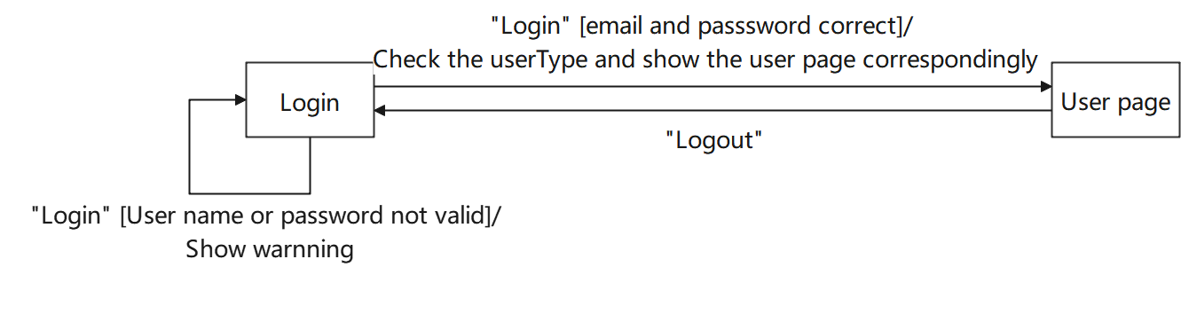
Login
Notes:
The user who already has an account can enter the email and password to log in. When clicking the "Log in" button, the user will enter different user interfaces according to the user type. You can see the state transition diagram between login page and users page

Slide 17
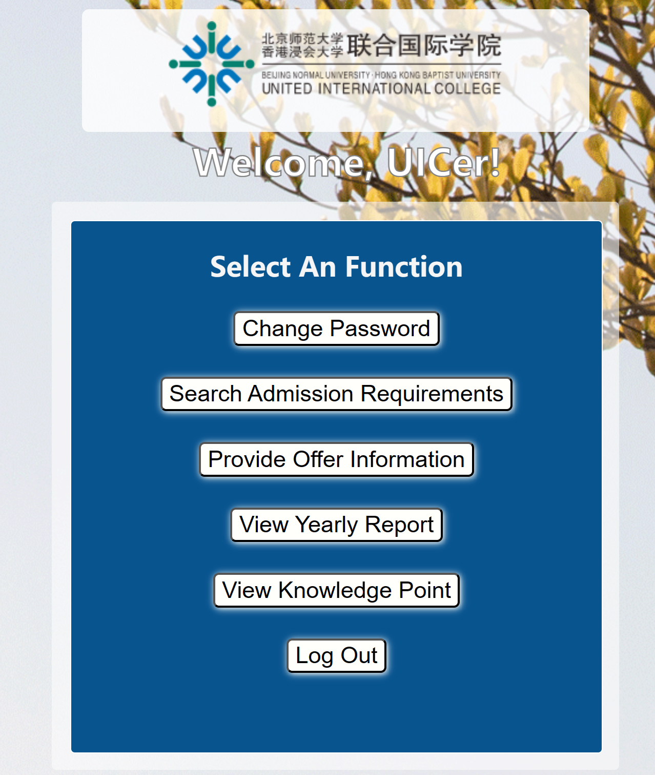
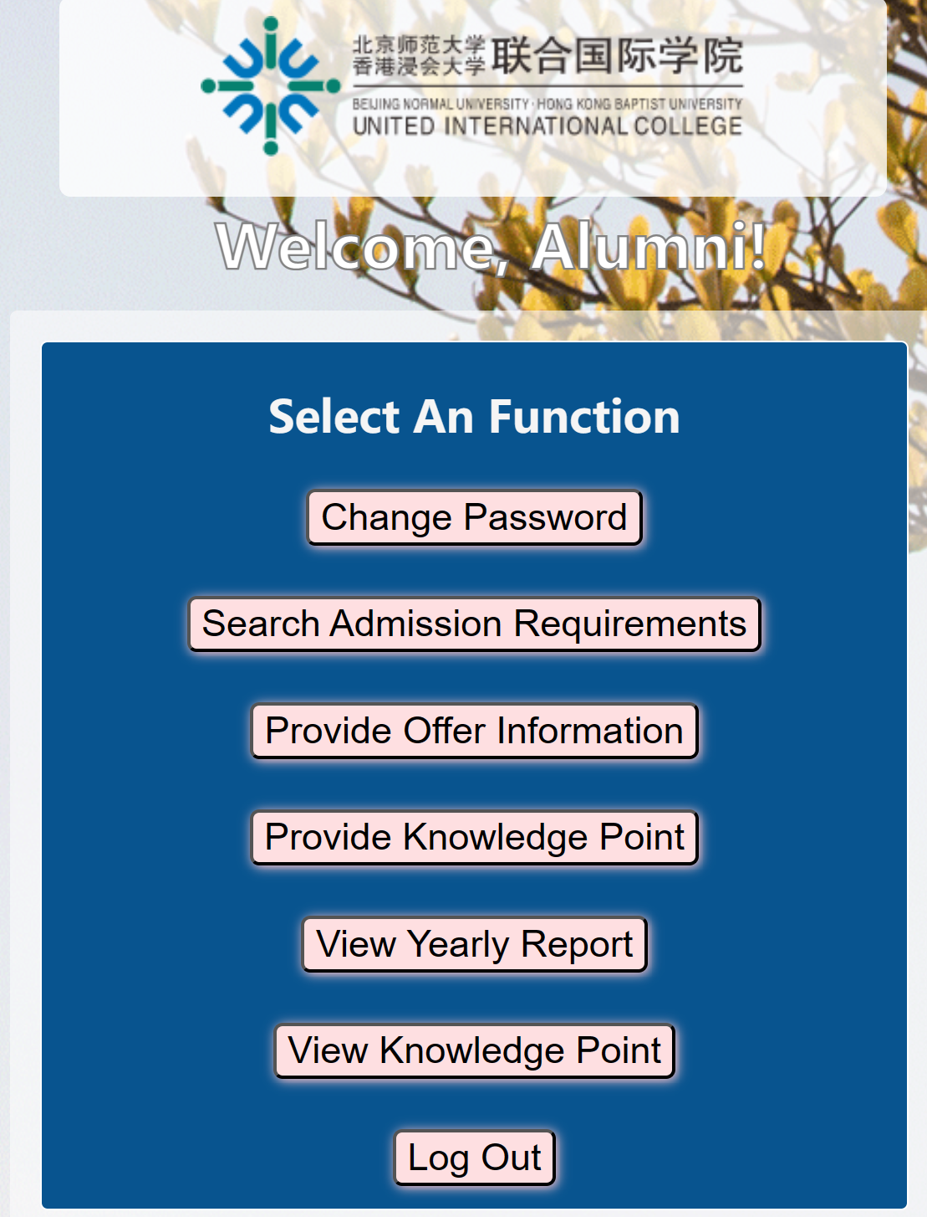
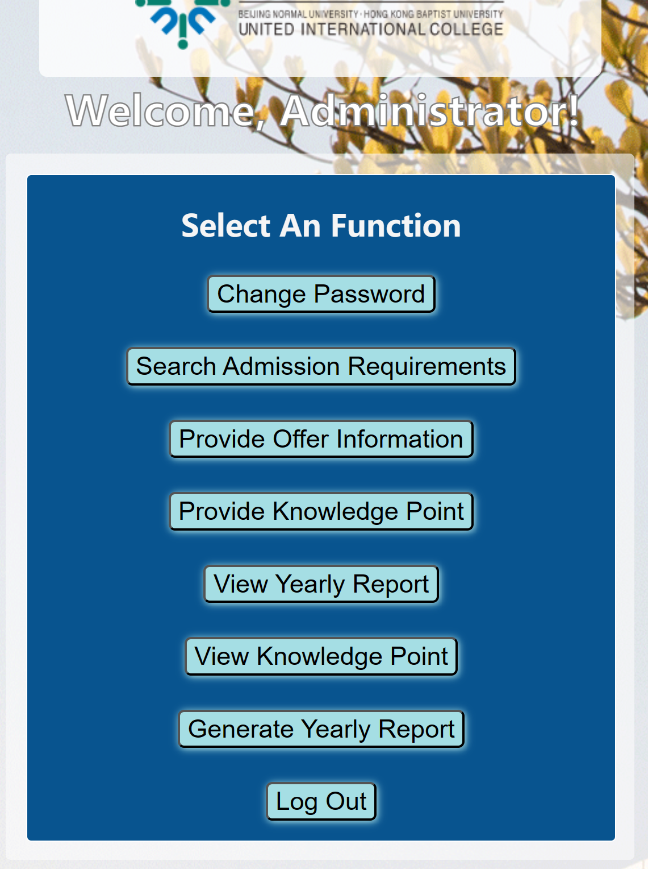
Log in and enter different user page
ui
Notes:
As you can see, different user types, UICer，alumni and administrator have different function buttons. Click buttons for different operation. Later, you can click the back button in each page to return to this home page again. The user's login information is maintained during this period without log in again.

Slide 18
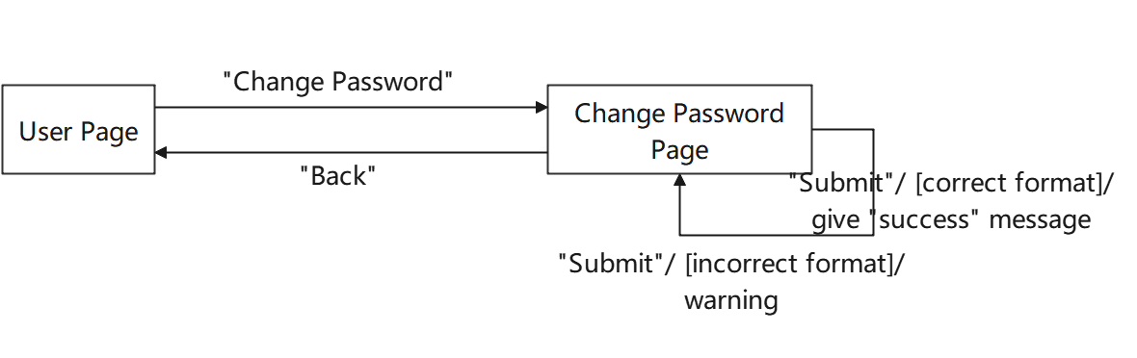
Notes:
Next, when we clink change password button, the state transition diagram is like this, then go to change password page

Slide 19
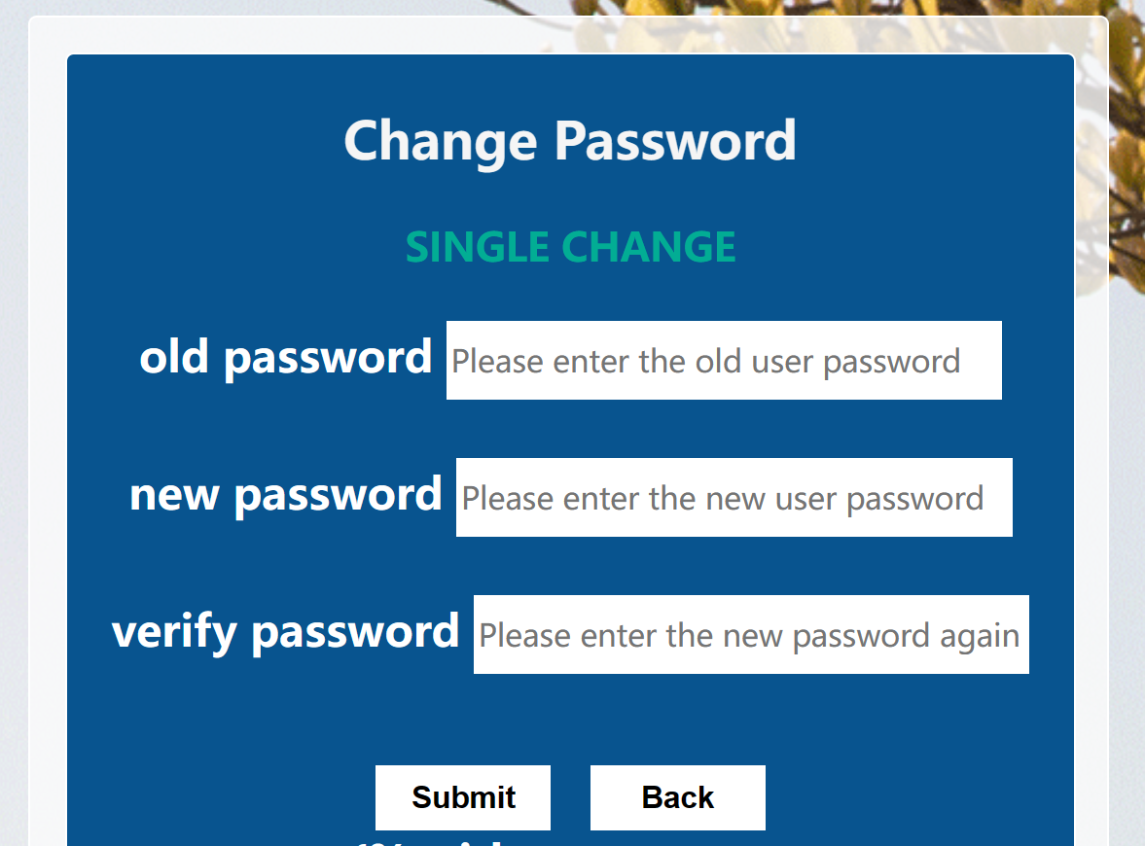
Change Password
Notes:
users can change password and chose to back home page for other operation

Slide 20
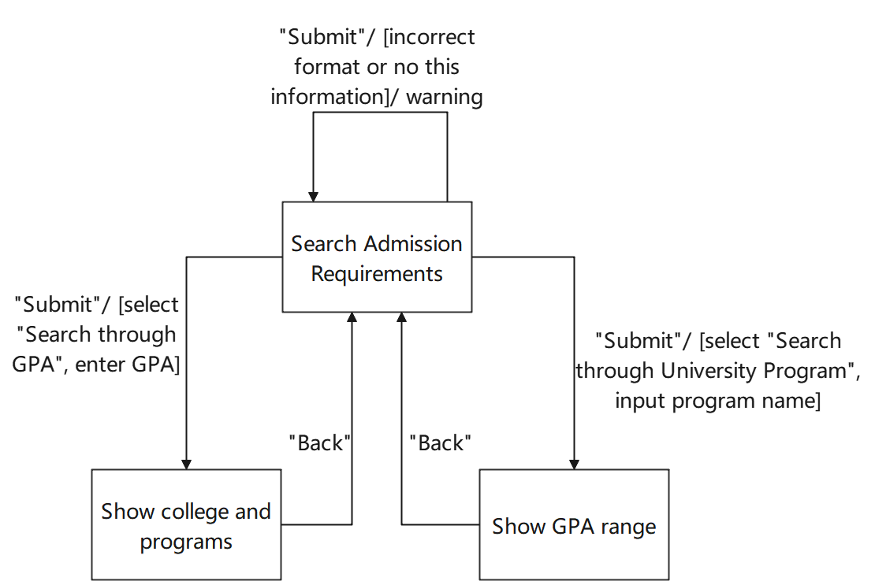
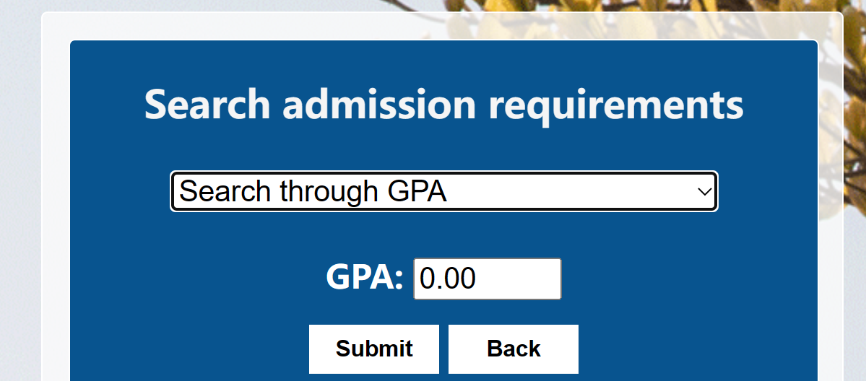
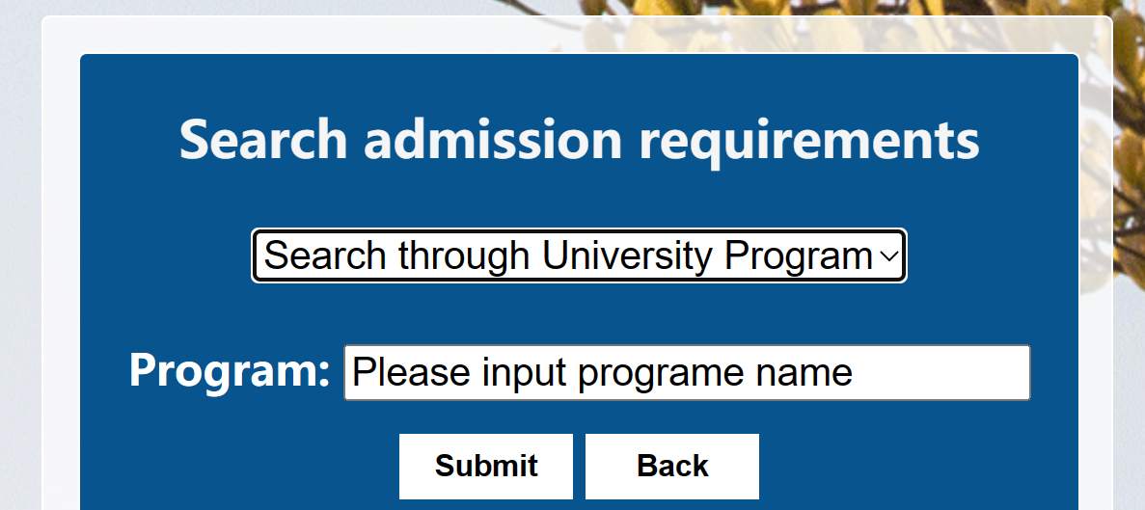
Search Admission Requirement
ui
Notes:
UICer and Alumni can enter GPA to search university program with GPA similar to the user’s GPA and also enter program name to search university and GPA range

Slide 21
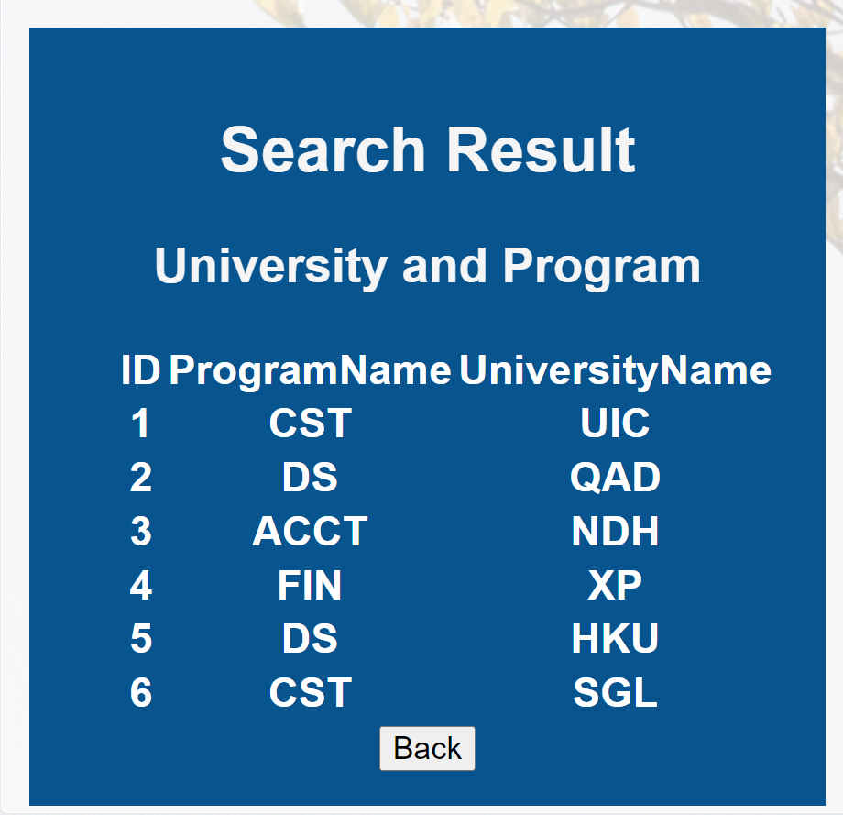
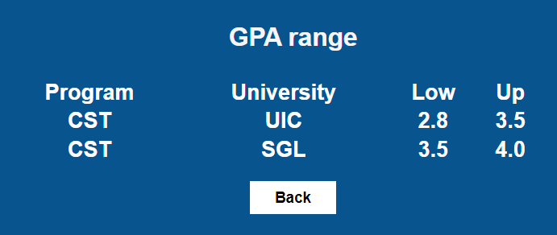
Search Admission Requirement
Show a table listing the universities and programs with required GPA under 3.5
Show a table listing the GPA range of the university which contains entered program CST
Notes:
click submit, then users can obtain the list of result university and GPA range

Slide 22
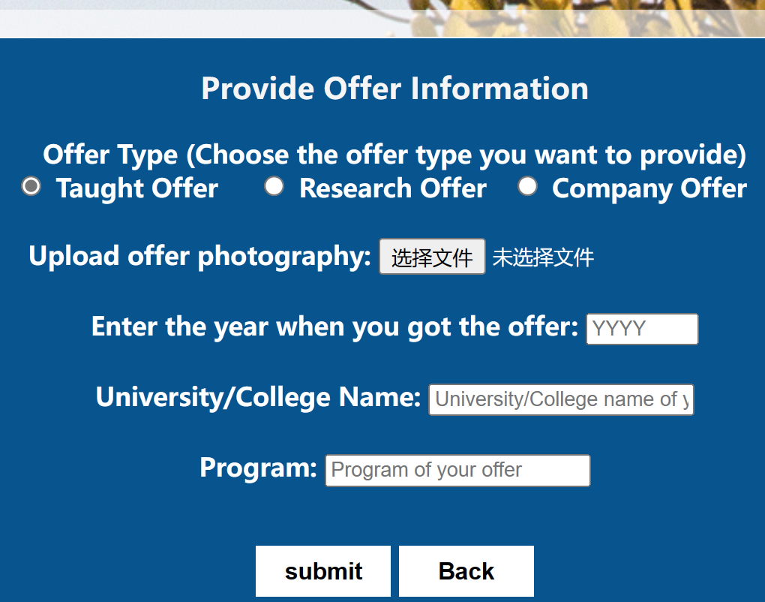
Provide Offer Information
Taught offer
Notes:
UICer and alumni who get an offer can provide information about their offer, they can chose the offer type to upload. Click taught offer, students should upload offer image to prove its authenticity.

Slide 23
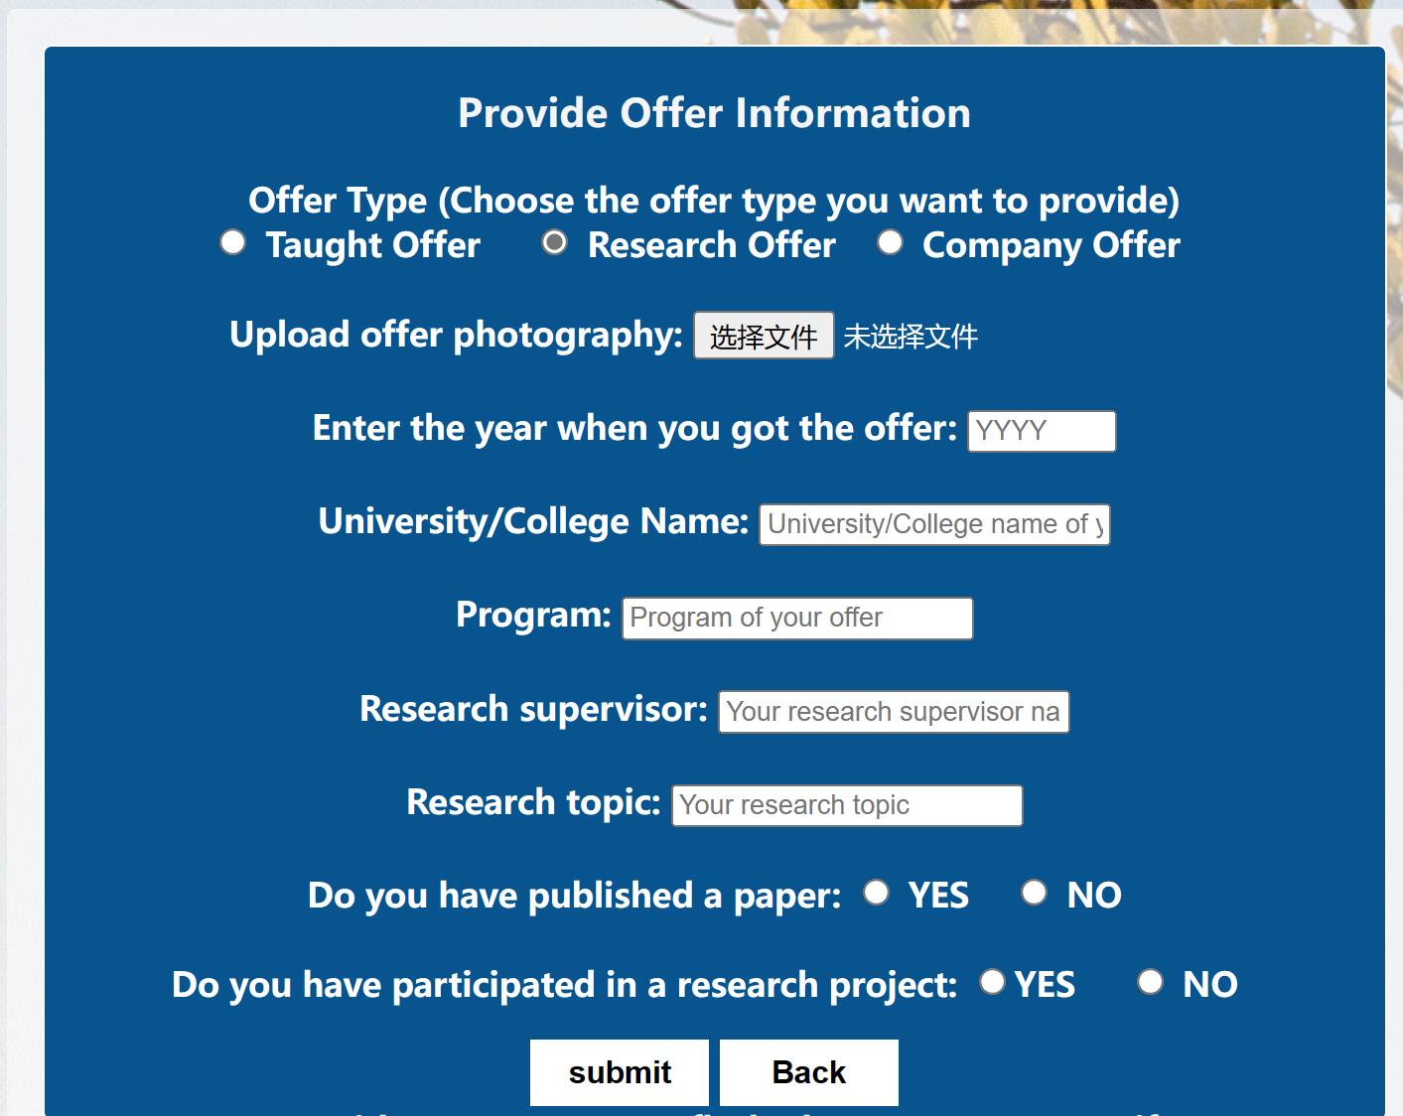
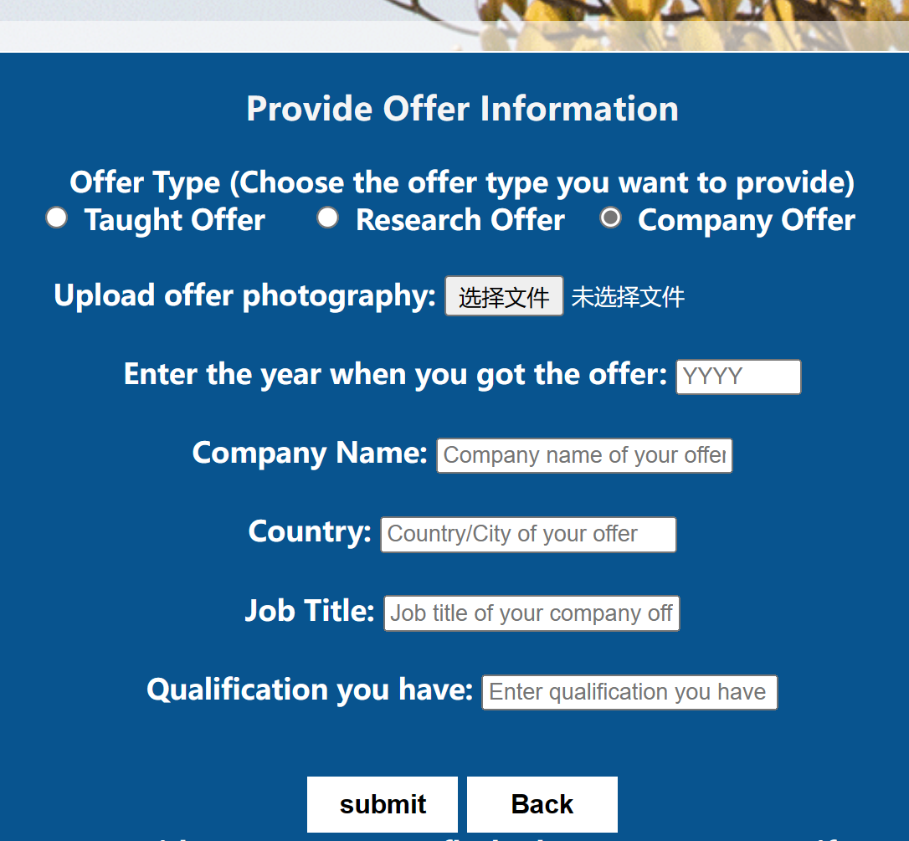
Provide Offer Information
Reseach offer
Company offer
ui
Notes:
For other type offers- say, research offer, students need to enter more information, such as the supervisor name, research topic. Students can also provide their job offer from company. Here you don’t need to enter your GPA and Name, since you are currently logged in, the system will automatically obtain your basis information to record.

Slide 24
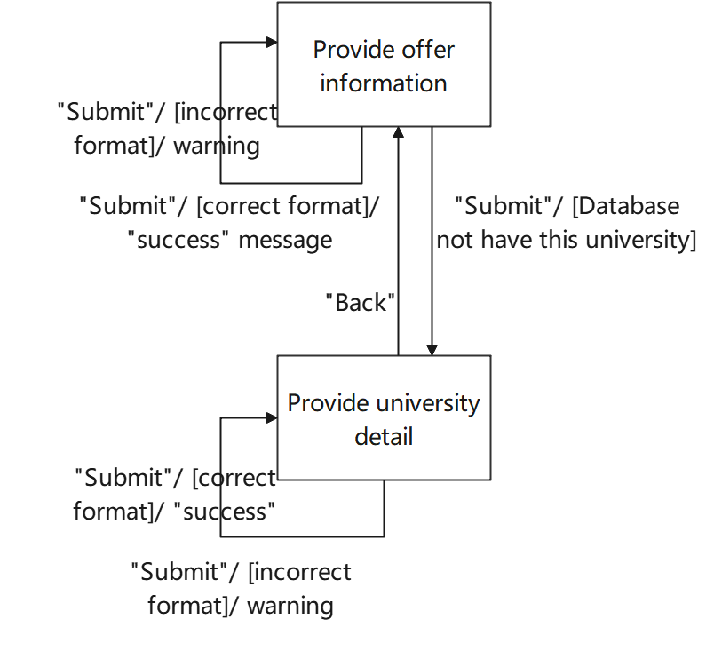
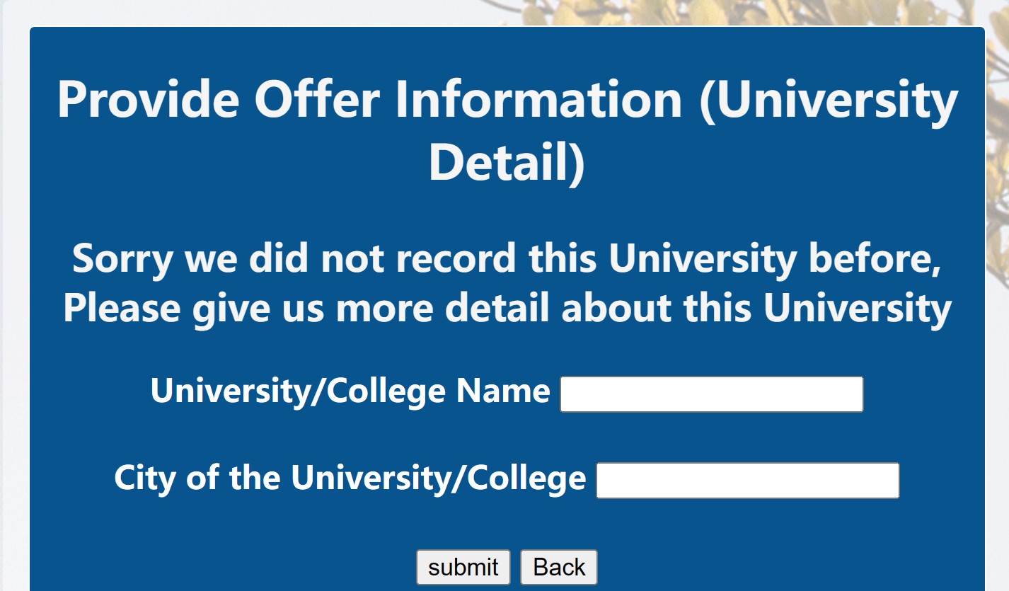
Provide Offer Information
-- University details
If the university is not in our database,
system will ask user to give details of this university
Notes:
However if the entered university is not in our database，the system will jump to a new page asking for more detail about university, and then a new university will be added into our database. Don't worry, you don't need to enter the offer information again, in order to be user-friendly, we keep the previous offer information, students only need to enter the new university details.
可不说
When add offer successfully, click back button ,go back to offer provide page, students can continue provide another offer information if necessary.

Slide 25
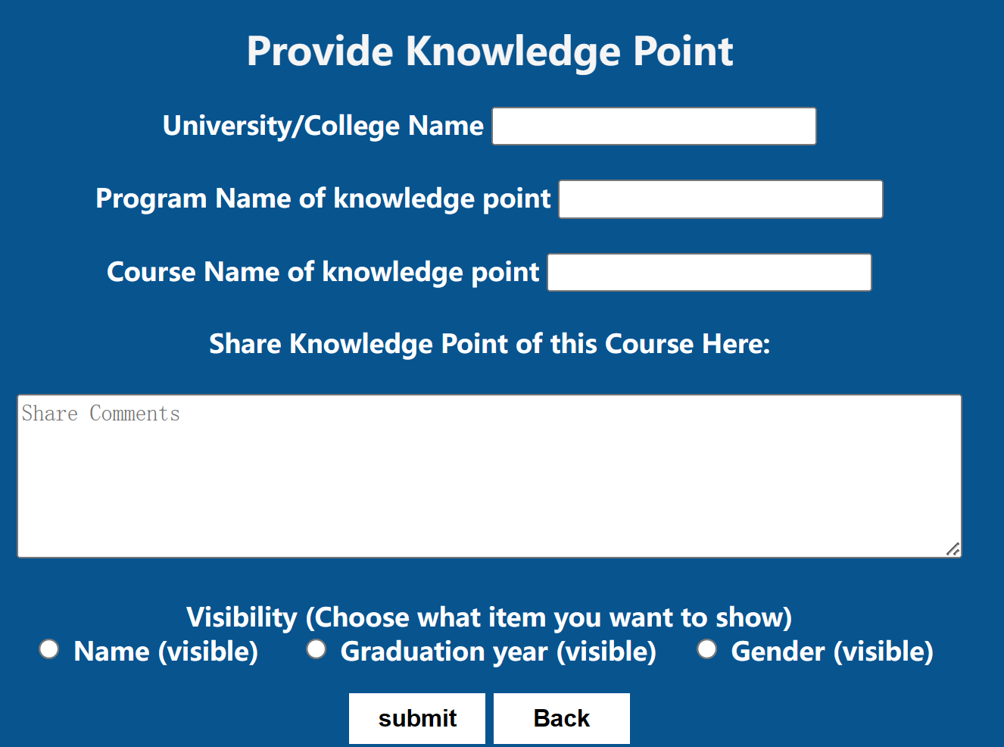
Provide Knowledge Point
state transaction
Notes:
Next, Alumni can share knowledge points related to their courses, so that other students can know more about the postgraduate programs. Here alumni can select whether to show their real name, graduation year, gender with the knowledge points they shared.

Slide 26
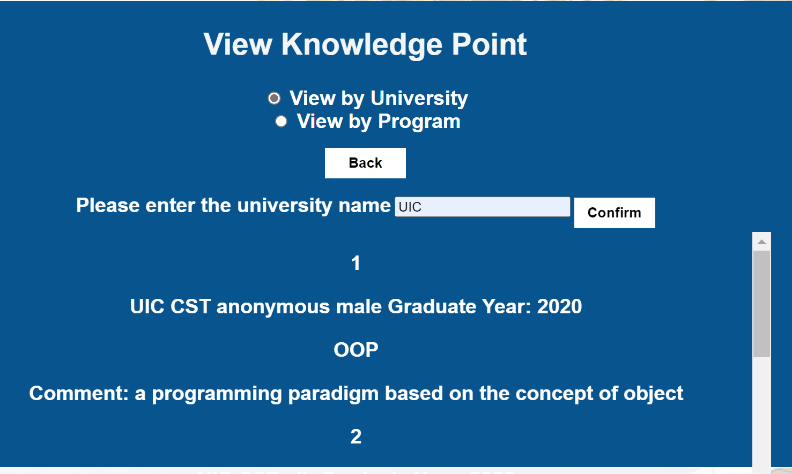
Can show whether the Alumni want to share their name, graduate year and gender correspondingly
Blogger info
Course name
Notes:
UICer and other alumni can view knowledge point by searching university name or program name. the shared comments will be list below. This is a OOP knowledge point provide by a male alumni who don’t want to be named and graduated in 2020. You can drag the scroll bar on the side to see more comments.

Slide 27
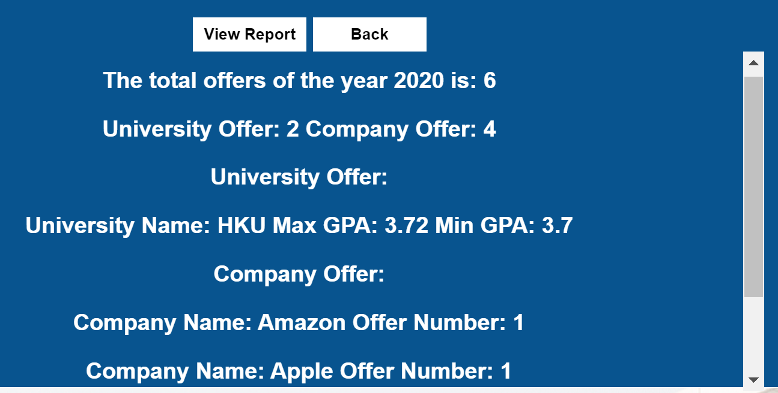

View Yearly Report
Notes:
UICer and alumni can select which year to view the UICer admission report.
In order to protect privacy, students cannot see a specific offer , but can view the GPA range of students admitted to a school.
In addition, students can also view the company offer, which can give them a reference.

Slide 28
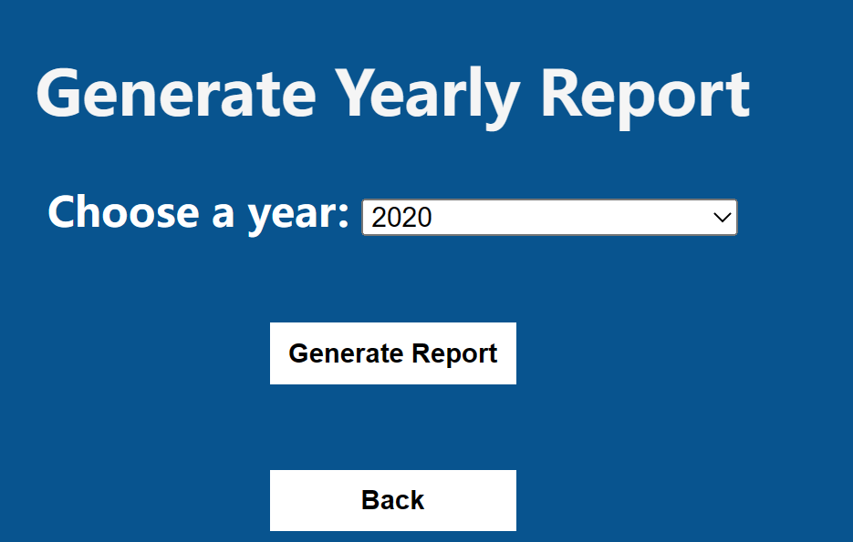
Generate Yearly Report
Notes:
Every once in a while, the administrator log in to generate the current yearly report, the previous yearly report will be updated, and the students can see the latest report.

Slide 29
Complete & Reliable
User Type Update
Automatically check the user's email,
change user type UICer to alumni after graduating
Information Consistency
New offer added, new information of university and program will be updated in database respectively.
Notes:
Our system can keep the information updated and consistent at all times. First, say, if a student graduates this year, the system will automatically determine the first letter of the UICer email address and change the user type to alumni in June. In addition, every time a student provides new offer information, the system will automatically detect whether the university and the program are included in the database, and make corresponding supplements. So users can trust that our system is complete and reliable. Next, demo

Slide 30
04 LIVE DEMO
Give a live demonstration
。。。
GPS

Slide 31
THANKS!

